Slide 1
What is Version Control?
Module 5 – Version Control with GIT

Slide 2
Version control (also known as source control or revision control) is the practice of tracking and managing changes to code
Source control is vital for managing software development projects
Being able to track changes to code allows developers to:
centralise all code changes and additions into one code repository
collaborate effectively and work in teams
control the integration of new code into the codebase
track changes from the entire team over the full lifetime of the project
revert code back to previous versions
What is Version Control?

Slide 3
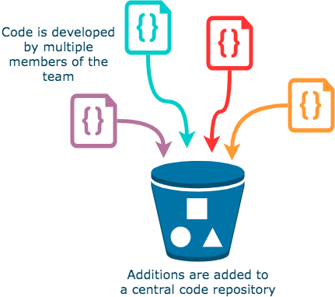
Repositories
Version control stores code in a repository. This essentially functions as a big bucket for all your code to live in!
Having one place where your code resides means that versioning stays consistent, regardless of who's working on it.
This is vital when developers are working on the same project in tandem with one another – if there was no repository, there would be no cohesion or central codebase.

Slide 4

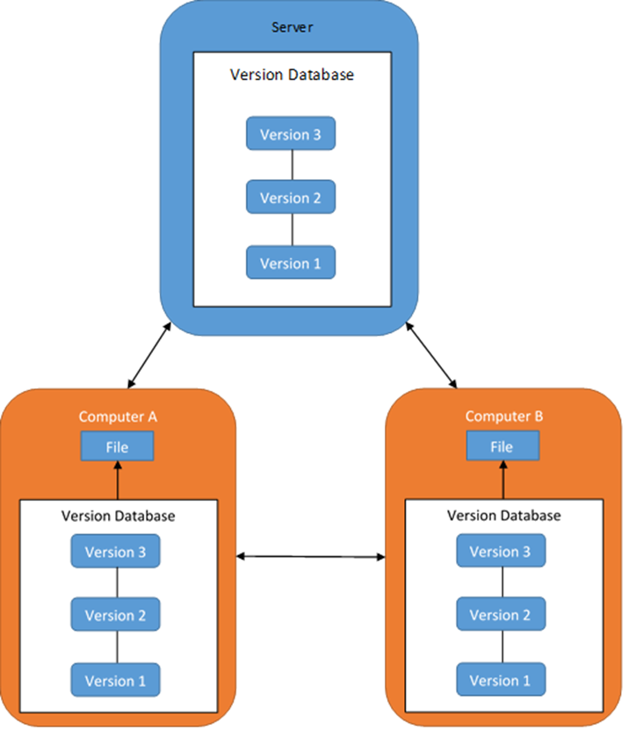
Version control structure
In a version control system, all work is held on a server, but the repository is mirrored locally when accessed
Several remote repositories are created, which essentially creates backups of the central repo!
With this, there is no single point of failure
Notes:
Ask the learners what single point of failure could mean, then give them an explanation e.g.:
Single point of failure is a flaw in design whereby one component of a system failing means the entire system fails. In theory, the single point of failure in a VCS is the server, but with multiple remote repos being made when accessed, version control avoids this.

Slide 5

Introducing Git version Control
Git is a version control system used by thousands around the world, and is arguably one of the most popular version control system (VCS) tools in software development
It can be used stand-alone or through inclusion within an IDE such as Eclipse, Visual Studio, or VS Code
During this module, we will be using the Git CLI (Git Bash) and a web-based UI for its repository (GitHub)

Slide 6
Repository Hosting Services
There are several web-based version control repository hosting services, most of which either utilise or are wholly based upon Git, such as:
GitHub (this is what we will use in this module!)
GitLab
Bitbucket
Many cloud providers have their own code repository offerings which offer simple and powerful integration with other cloud services:
AWS CodeCommit
Azure Repos (as part of Azure DevOps)
Google Cloud Source Repositories

Slide 7
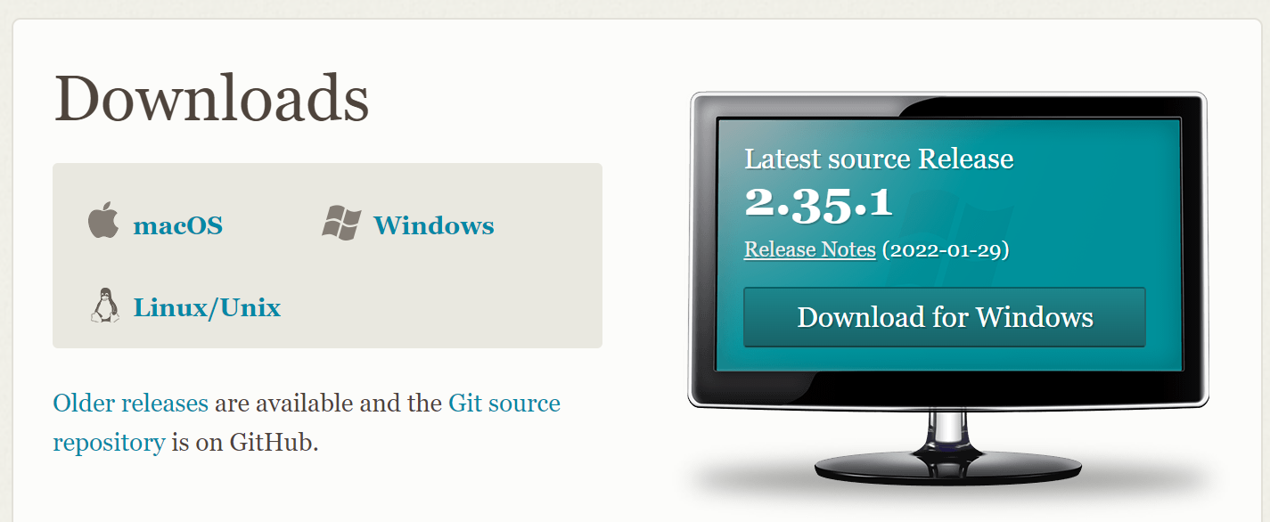
If you don’t already have Git downloaded, you can download and install the version of Git required for your operating system here:
https://git-scm.com/download
Installing Git and Git Bash
Notes:
https://git-scm.com/download
The Git Bash client tool comes included as part of the Git For Windows package. Git Bash is a terminal application for Windows that makes issuing git commands and terminal commands consistent with Linux terminals. It also provides colour-coding and is branch aware.

Slide 8
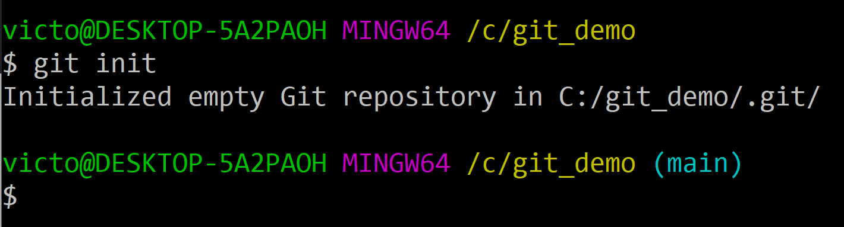
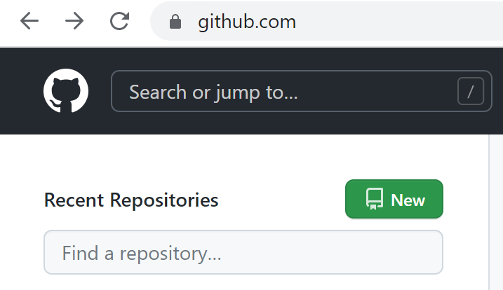
Repositories: local and remote
Local repositories:
Reside on a developer’s machine
Are accessible by that one developer
Are usually linked to a remote repository to enable pushing and pulling of team members’ code changes
Are created using the git init command
Remote repositories:
Reside on a repository hosted Git Server
Are accessible to all team members who can git clone the repo
Enable developers to push their local code to this remote repository and pull down their team’s code to their local repository
Created on a Git Server using a GUI

Slide 9
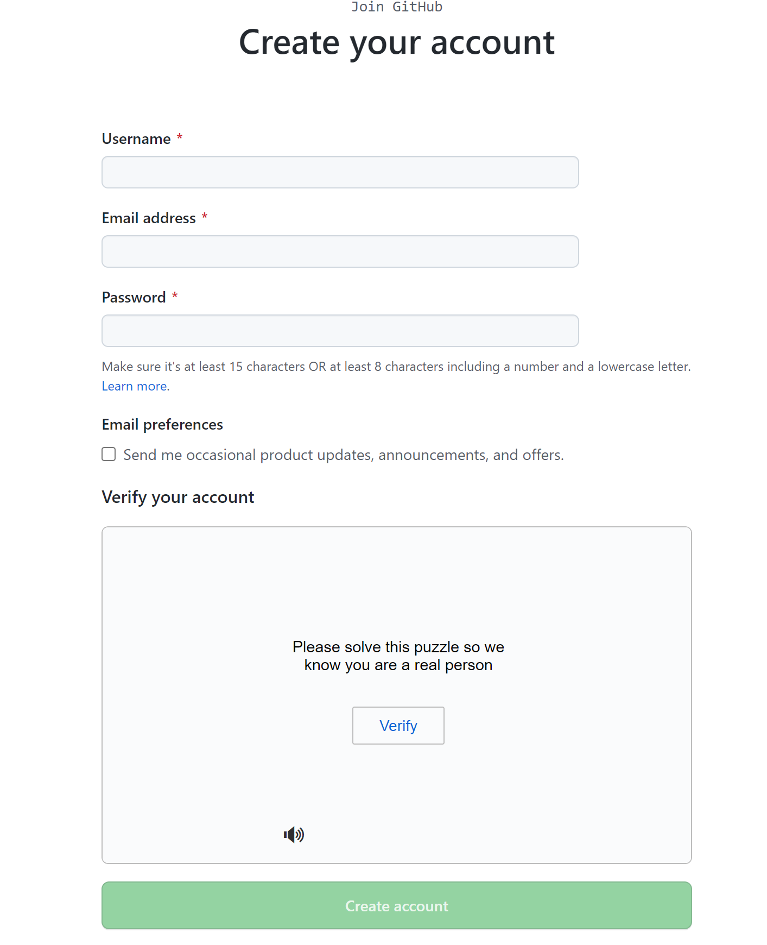
Sign-up for a GitHub account: https://github.com/join
GitHub:
Signing up for an Account

Slide 10
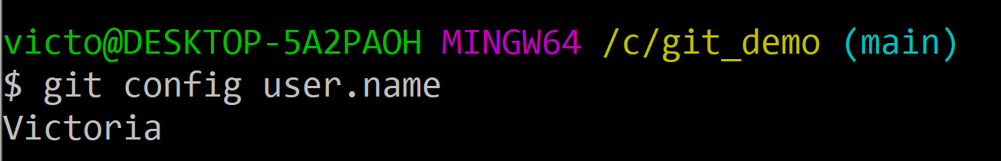
Once you’ve made an account, you then need to configure Git locally
Git needs to know who you are to enable you to commit code to repositories. Use the git config commands as follows:
To confirm you have configured your user.name:
Configuring Git locally

Slide 11
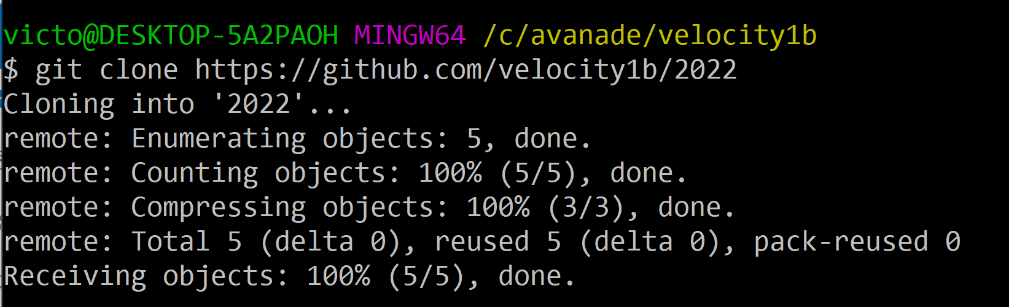
The git clone allows the cloning of a repository to a newly created directory
Once the clone is created locally, git fetch can be executed to get updates for the remote branches
This lets us keep our local branch up to date with changes on the remote
Use git clone to copy and link to a remote repo:
Cloning a repository
# git clone https://github.com/velocity1b/2022

Slide 12
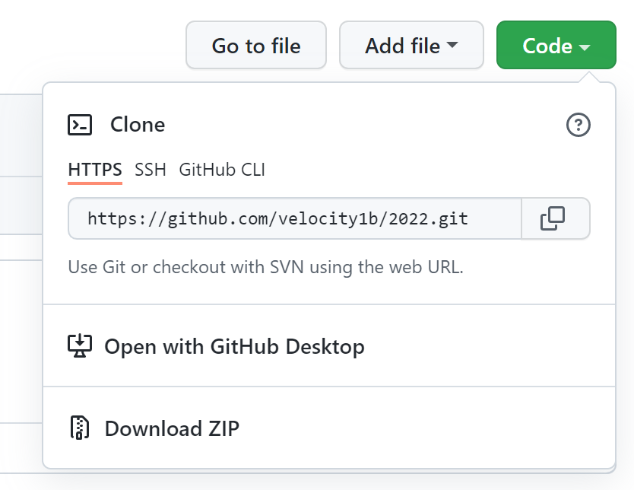
In order to clone a repository, you need to know the URL of the repository you want to clone.
To get the URL of the repository you want to clone, you need to go to that repository in the VCS (Version Control System) you are using, such as: GitHub.
In GitHub, you can find the URL by selecting the green Code button within the repo.
Cloning a Repository: Step 1

Slide 13
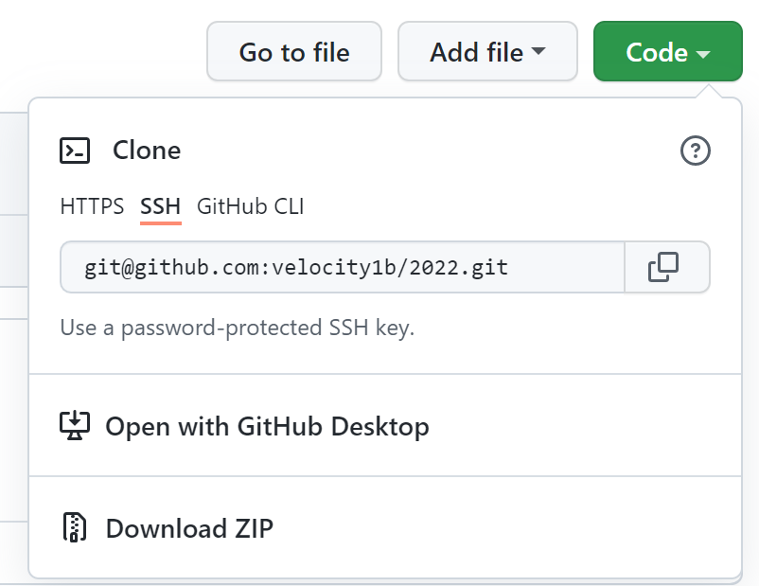
When you select the green Code button, you will have the option of three types of URLs to copy in order to clone a repository; HTTPS, SSH, and GitHub CLI
2. Select the SSH tab on the pop-up and copy the URL. The SSH URL should be in the format of:
For example:
Cloning a Repository: Step 2
git@github.com:[username]/[repository_name].git
git@github.com:velocity1b/2022.git

Slide 14
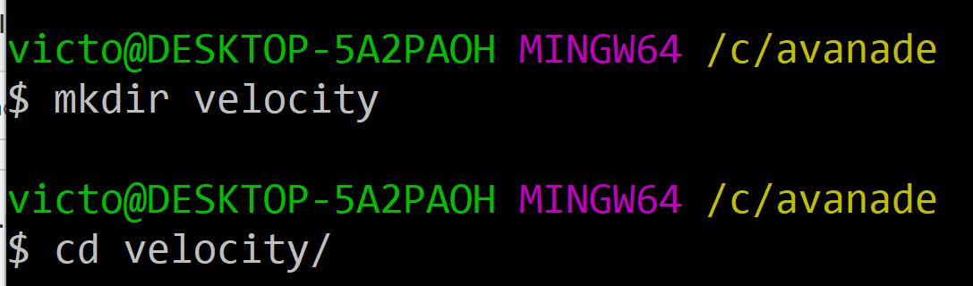
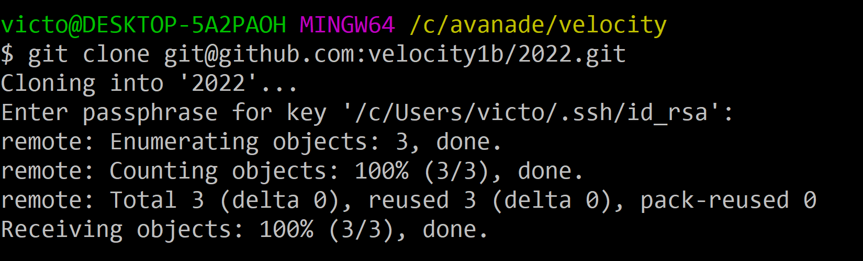
3. Open Git Bash and navigate to the directory where you want to save the cloned repository.
You may want to create a new directory using mkdir and change into that directory using the cd command
In this example, a new directory has been created and the remote repository has been cloned into it:
git clone git@github.com:[username]/[repository_name].git
Cloning a Repository: Step 3

Slide 15
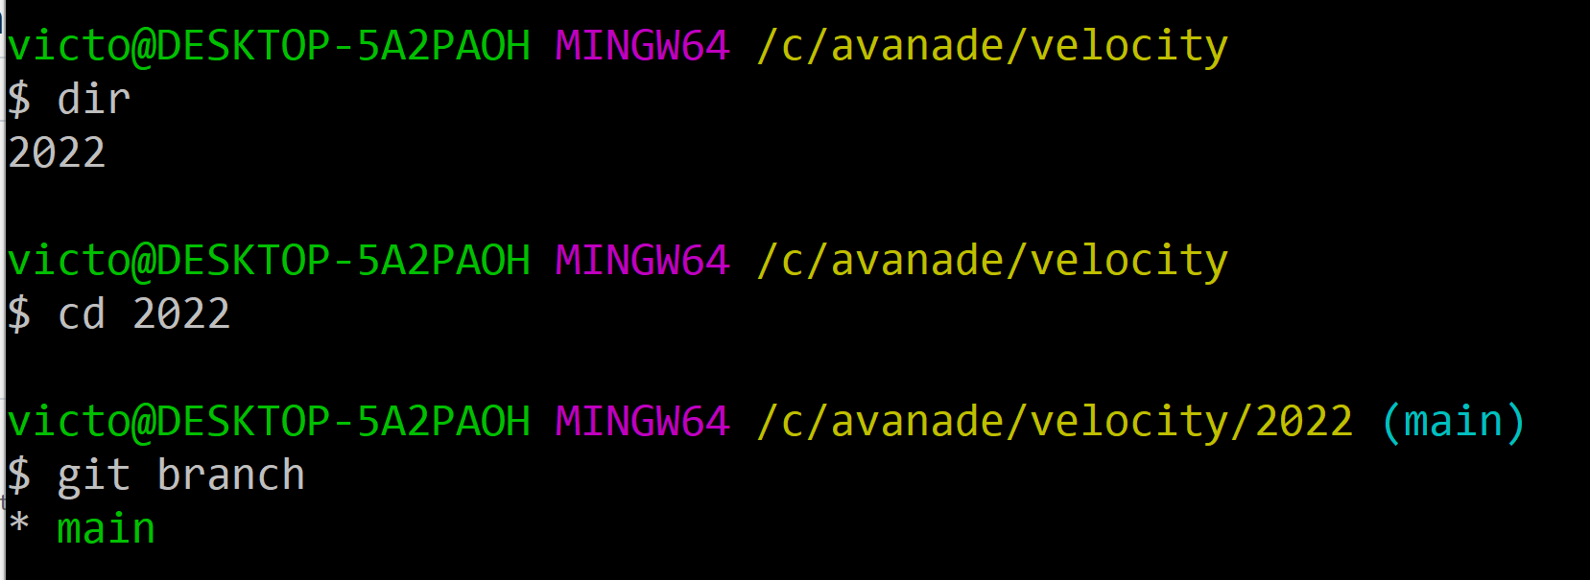
4. Once the repository has been cloned locally, change to the project directory with the cd command into the local copy of the repository
Run the command git branch to check that the active branch has been checked out.
For example:
Cloning a Repository: Step 4

Slide 16
Exercise 1: Getting Started
Create a Git account
Create a new Git repository
Clone the repository

Slide 17
End of section

